Slide 2
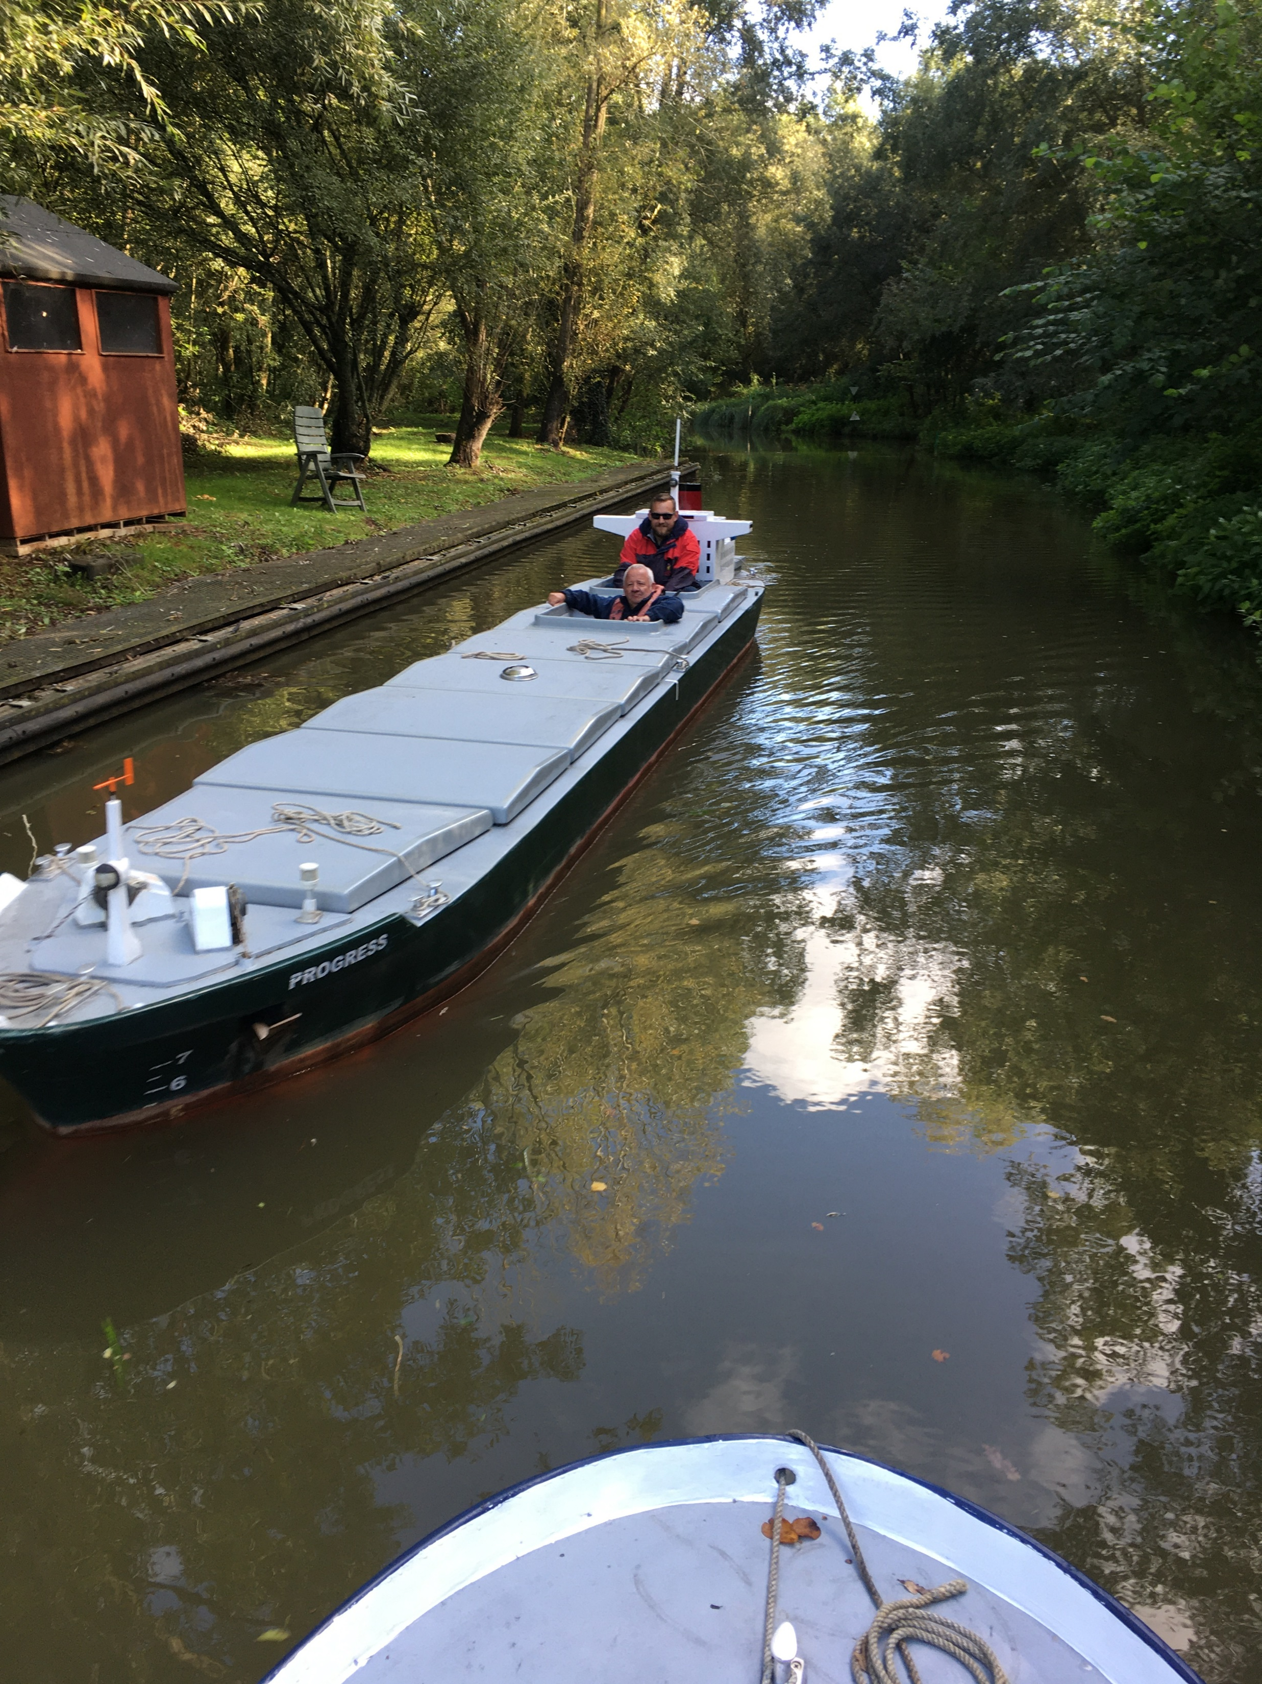
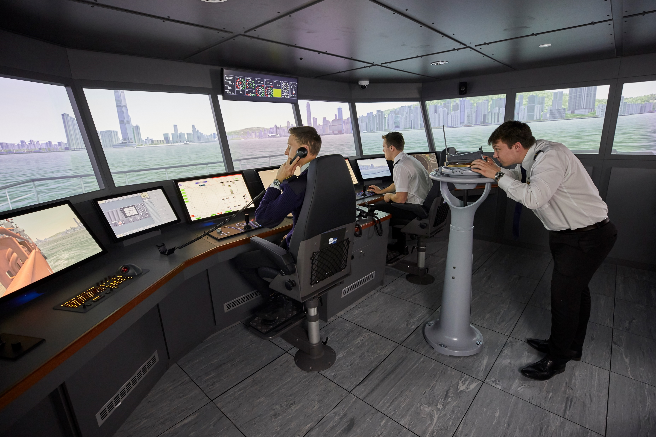


IGNITE Project – Summary
Optimising Remote Control of an Unmanned Merchant Ship of the future.
Manned Model used for Ship handling Training
Full Mission Bridge Simulator used for Navigation Training

Slide 3
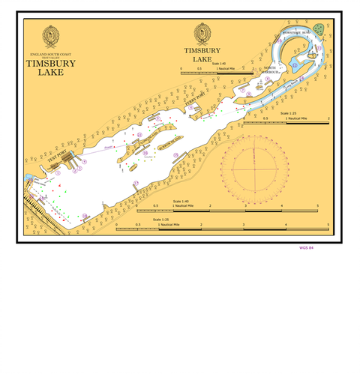

Planned WIFI Coverage

Slide 4
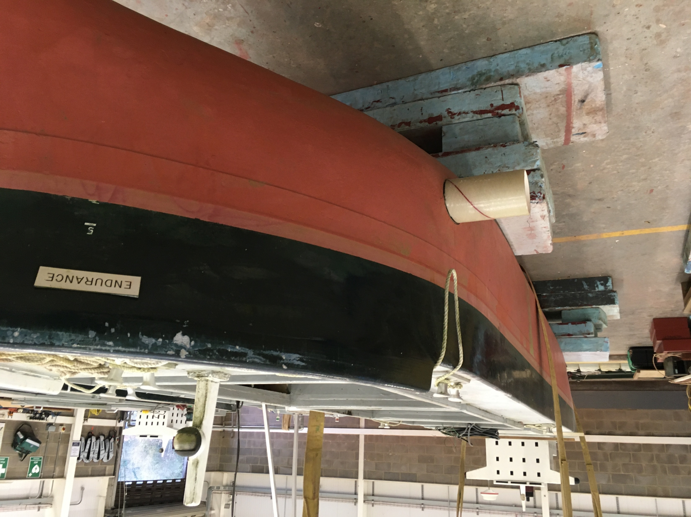
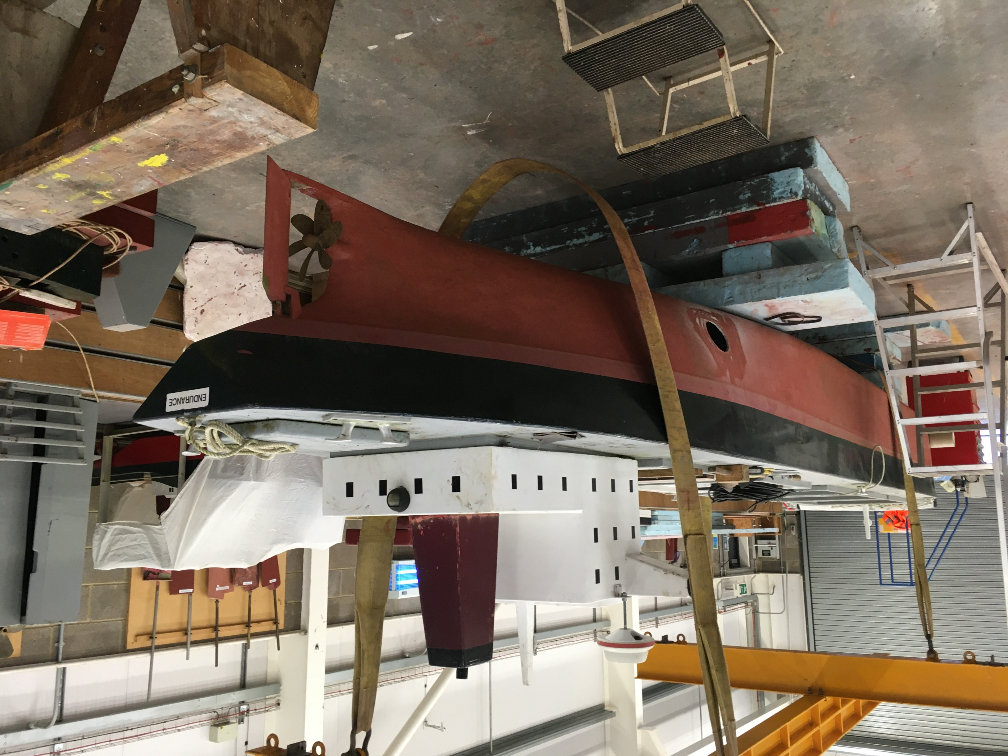
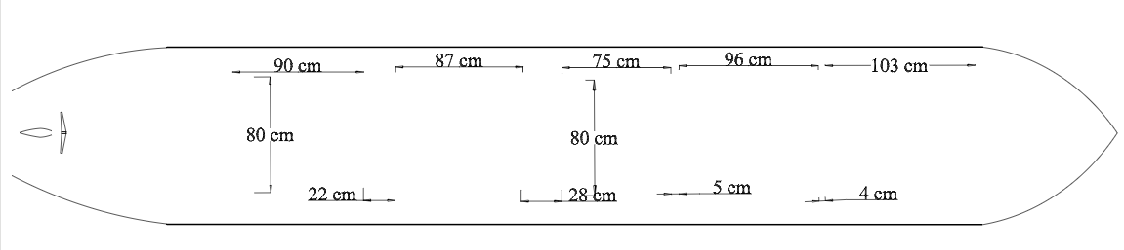
Example Of Ship Model For Remote Control

Slide 5
Project IGNITE – “What Are The Aims?”
Optimising Configuration of Remote Control Unmanned Ships
Specifying A Secure Remote Site Network Link for the Remote Control of Unmanned Ships
What We Are Looking For….
Wireless Connectivity between unmanned ships and internet based remote controller –
Has to be low in latency below 20ms , and achieve maximum coverage across the lake with minimal “blackspots”.

Slide 6
Project IGNITE – “What Are The Aims?”
Optimising Configuration of Remote Control Unmanned Ships
Specifying A Secure Remote Site Network Link for the Remote Control of Unmanned Ships
What We Are Looking For….
Site To Site Link between Simulator at Solent Campus and control centre for unmanned ships
Has to be low in latency below 50ms.
Has to be secure from unauthorised access.
Used by staff/students only from a remote control centre based at the lake. To control one ship only at any time, whilst others are transmitting data.

